Slide 1
Object-Oriented Systems Analysis and Design Using UML (Use Case Diagram)
Systems Analysis and Design Lab
Course Code: CSE 306
Fall 2021 Semester
Instructor:
Ali Zafar Sadiq
Lecturer, UAP
Notes:
‹#›

Slide 2
Major Topics
Object-oriented Systems Analysis and Design
Unified Modelling Language (UML)
Use case and other UML diagrams
18-‹#›
Notes:
‹#›

Slide 3
Object-Oriented Overview
Object-oriented (o-o) techniques work well in situations where complicated systems are undergoing continuous maintenance, adaptation, and design.
The Unified Modelling Language (UML) is an industry standard for modelling and designing object-oriented systems.
18-‹#›
Notes:
‹#›

Slide 4
Goals of O-O Analysis
Reusability is the main goal.
Maintaining the systems is an important goal.
18-‹#›
Notes:
‹#›

Slide 5
Two General Groupings of Things
There are two general groupings of things in UML:
Structural things that define the conceptual (theoretical) and physical structures of an O-O system and are described by nouns.
Behavioral things, the verbs of a UML model that represent the behavior of the system and the states of the system before, during, and after the behaviors occur.
18-‹#›
Notes:
‹#›

Slide 6
Commonly Used UML Diagrams
The most commonly used UML diagrams are:
Use case diagram
Activity diagram
Sequence diagram
Class diagram
18-‹#›
Notes:
‹#›

Slide 7
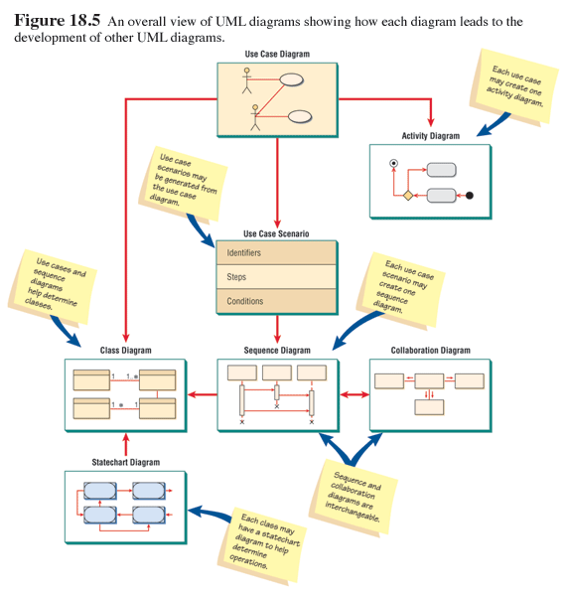
Overview of UML Diagrams
18-‹#›
Notes:
‹#›

Slide 8
Use Case Diagram
A use case describes how a user uses a system to accomplish a particular goal. A use case diagram consists of the system, the related use cases and actors and relates/connects these to each other to visualize: what is being described? (system), who is using the system? (actors) and what do the actors want to achieve? (use cases), thus, use cases help ensure that the correct system is developed by capturing the requirements from the user's point of view.
18-‹#›
Notes:
‹#›

Slide 9
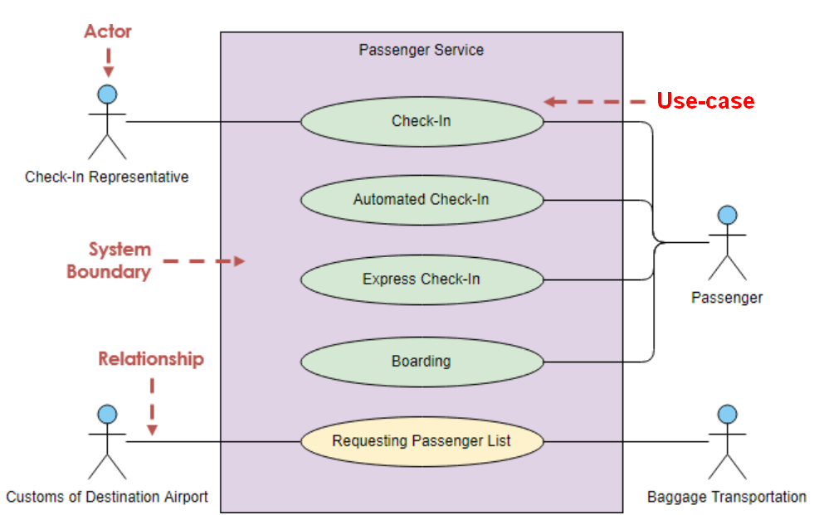
Use Case Diagram Notations
Use cases define interactions between external actors and the system to attain particular goals. A use case diagram contains four main components.
18-‹#›
Notes:
‹#›

Slide 10
Use Case Diagram Notations
Actor
Actors are usually individuals involved with the system defined according to their roles. The actor can be a human or other external system.
Use Case
A use case describes how actors uses a system to accomplish a particular goal. Use cases are typically initiated by a user to fulfill goals describing the activities involved in attaining the goal.
Relationship
The relationships between and among the actors and the use cases.
System Boundary
The system boundary defines the system of interest in relation to the world around it.
18-‹#›
Notes:
‹#›

Slide 11
Benefits of Use Case Diagram
Use cases is a powerful technique for the process of developing and documentation of functional requirements.
Use cases are easy to understand and provide an excellent way for communicating with customers and users as they are written in natural language.
Use cases can help manage the complexity of large projects by partitioning the problem into major use cases/ features.
A use case scenario involves the collaboration of multiple objects and classes
Use cases provide a good basis to link between the verification and the validation of the model.
Use case driven approach provides an traceable links for project tracking in which the key development activities such as the use cases implemented, tested, and delivered fulfilling the goals and objectives from the user point of views.
18-‹#›
Notes:
‹#›

Slide 12
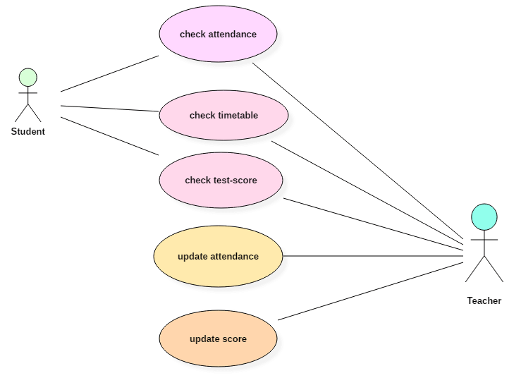
Example of Use Case Diagram
Following use case diagram represents the working of the student management system:
18-‹#›
Notes:
‹#›

Slide 13
Example of Use Case Diagram
An automated teller machine (ATM) or the automatic banking machine (ABM) is a banking subsystem (subject) that provides bank customers with access to financial transactions in a public space without the need for a cashier, clerk, or bank teller.
Customer (actor) uses bank ATM to Check Balances of his/her bank accounts, Deposit Funds, Withdraw Cash and/or Transfer Funds (use cases). ATM Technician provides Maintenance and Repairs. All these use cases also involve Bank actor whether it is related to customer transactions or to the ATM servicing.
18-‹#›
Notes:
‹#›

Slide 14
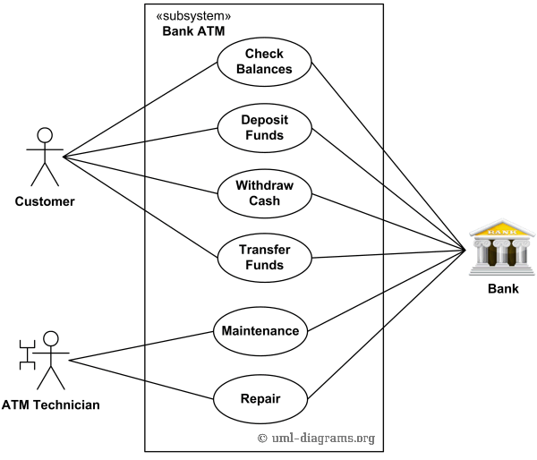
Example of Use Case Diagram
Following use case diagram represents the working of the student management system:
18-‹#›
Notes:
‹#›

Slide 15
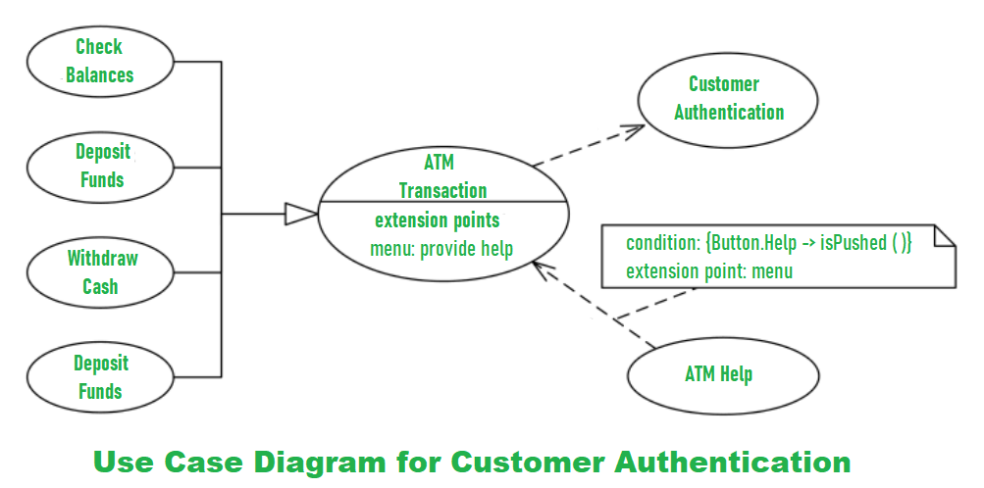
Example of Use Case Diagram
18-‹#›
Notes:
‹#›

Slide 16
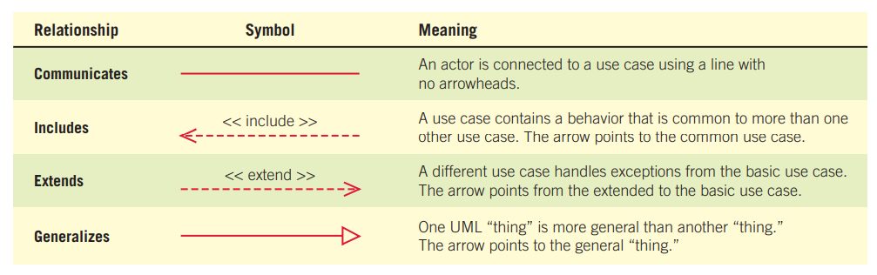
Use Case Relationships
Include implies Mandatory
Extend implies Optional
18-‹#›
Notes:
‹#›

Slide 17
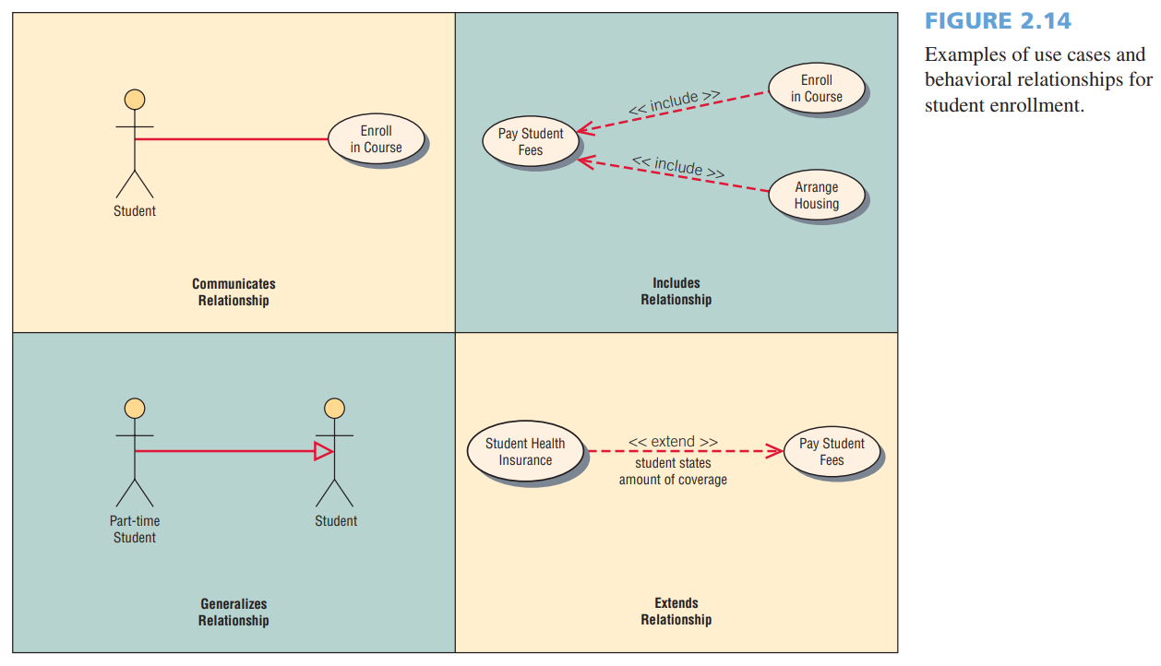
Use Case Relationships
18-‹#›
Notes:
‹#›

Slide 18
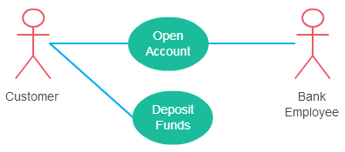
Association Between Actor and Use Case
Few things to note:
An actor must be associated with at least one use case.
An actor can be associated with multiple use cases.
Multiple actors can be associated with a single use case.
18-‹#›
Notes:
‹#›

Slide 19
Extend Relationship Between Two Use Cases
Here are a few things to consider when using the <<extend>> relationship.
The extending use case is dependent on the extended (base) use case. In the below diagram the “Calculate Bonus” use case doesn’t make much sense without the “Deposit Funds” use case.
The extending use case is usually optional and can be triggered conditionally. In the diagram, you can see that the extending use case is triggered only for deposits over 10,000 or when the age is over 55.
The extended (base) use case must be meaningful on its own. This means it should be independent and must not rely on the behavior of the extending use case.
Lets expand our current example to show the <<extend>> relationship.
18-‹#›
Notes:
‹#›

Slide 20
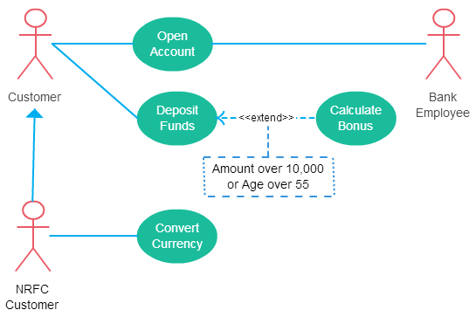
Extend Relationship Between Two Use Cases
Extend relationship in use case diagrams
18-‹#›
Notes:
‹#›

Slide 21
Include Relationship Between Two Use Cases
Include relationship show that the behavior of the included use case is part of the including (base) use case.
The main reason for this is to reuse common actions across multiple use cases.
In some situations, this is done to simplify complex behaviors.
Few things to consider when using the <<include>> relationship.
The base use case is incomplete without the included use case.
The included use case is mandatory and not optional.
18-‹#›
Notes:
‹#›

Slide 22
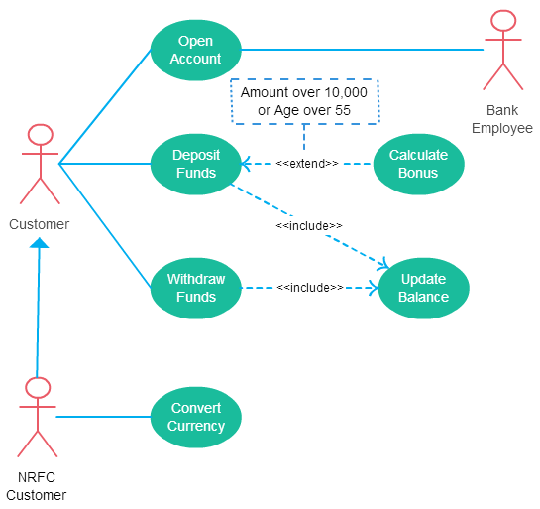
Include Relationship Between Two Use Cases
Let expand our banking system use case diagram to show include relationships as well.
Include relationship in use case diagrams
18-‹#›
Notes:
‹#›

Slide 23
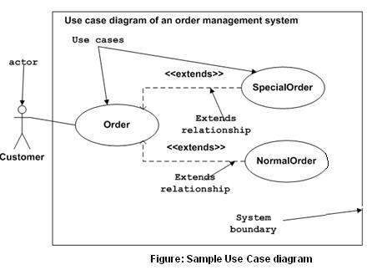
Example of Use Case Diagram
Following is a sample use case diagram representing the order management system. Hence, if we look into the diagram then we will find three use cases (Order, SpecialOrder, and NormalOrder) and one actor which is the customer.
The SpecialOrder and NormalOrder use cases are extended from Order use case.
Hence, they have extended relationship. Another important point is to identify the system boundary, which is shown in the picture. The actor Customer lies outside the system as it is an external user of the system.
18-‹#›
Notes:
‹#›

